Slide 1

Flow Control
School of Computer Science Engineering and Technology Bennett University
Greater Noida – 201310

Slide 2
Delays
Stop and Wait
Outline
Stop and Wait ARQ

Slide 3
Types of Delays
Delay is the time for which the processing of a particular packet takes place.
Types of Delays
Transmission
Propagation
Queuing
Processing

Slide 4


Types of Delays
Transmission delay: Time taken to put the data packet on the transmission link.
Transmission delay ∝ Length or Size of data packet
Transmission delay ∝ 1 / Bandwidth
𝐋𝐞𝐧𝐠𝐭𝐡 𝐨𝐟 𝐝𝐚𝐭𝐚 (𝐋)
𝑻_{𝒕} =
𝐁𝐚𝐧𝐝𝐰𝐢𝐝𝐭𝐡 (𝐁)
This delay depends upon the number of active sessions, bandwidth, MAC protocol
Propagation delay: Time taken for one bit to travel from sender to receiver end of the link.
Propagation delay ∝ Distance between sender and receiver
Propagation delay ∝ 1 / transmission speed
𝐃𝐢𝐬𝐭𝐚𝐧𝐜𝐞 𝐛𝐞𝐭𝐰𝐞𝐞𝐧 𝐬𝐞𝐧𝐝𝐞𝐫 𝐚𝐧𝐝 𝐫𝐞𝐜𝐞𝐢𝐯𝐞𝐫
𝐓_{𝐩} =
𝐓𝐫𝐚𝐧𝐬𝐦𝐢𝐬𝐬𝐢𝐨𝐧 𝐬𝐩𝐞𝐞𝐝

Slide 5
Types of Delays
Queuing delay: Time spent by the data packet waiting in the queue before it is taken for execution.
It depends on the congestion in the network, size of the queue, arrival rate of packets, number
of servers/links.
Processing delay: Time taken by the processor to process the data packet.
It depends on the speed of the processor.
Processing of the data packet helps in detecting bit level errors that occurs during transmission.
^{𝑇}𝑡𝑜𝑡𝑎𝑙 ^{= 𝑇}𝑡 ^{+ 𝑇}𝑝 ^{+ 𝑇}𝑄 ^{+ 𝑇}𝑝𝑟𝑜
𝑇_{𝑡𝑜𝑡𝑎𝑙} = 𝑇_{𝑡} + 𝑇_{𝑝} When 𝑇_{𝑄} and 𝑇_{𝑝𝑟𝑜} is zero

Slide 6
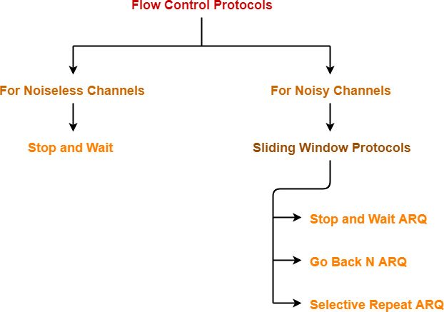
Flow Control Protocols
A set of procedures which are used for restricting the amount of data that a sender can send
to the receiver.

Slide 7
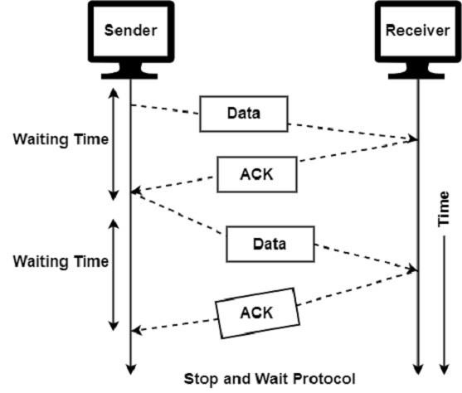
Stop and Wait
After sending the data, sender stops and waits
until he/she receives the acknowledgment from
the receiver.
It is used for transmitting the data over the noiseless channels.
It provides unidirectional data transmission which
means that either sending or receiving of data will
take place at a time.
Working:
Sender sends a data packet to the receiver.
Sender stops and waits for the acknowledgement for the sent packet from the receiver.
Receiver receives and processes the data packet.
Receiver sends an acknowledgement to the sender.
After receiving the acknowledgement, sender sends the next data packet to the receiver.

Slide 8
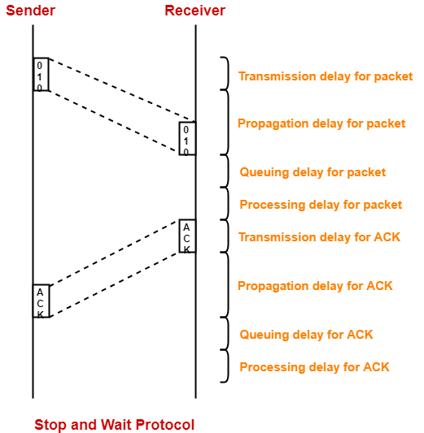
Stop and Wait Transmission Process
Sender puts the data packet on the transmission link.
Packet propagates towards the receiver’s end.
Packet reaches the receiver and waits in its buffer.
Receiver processes the data packet.
Receiver puts the acknowledgement on the
transmission link.
Acknowledgement propagates towards the sender’s end.
Acknowledgement reaches the sender and waits in
its buffer.
Sender processes the acknowledgement.

Slide 9

Stop and Wait Transmission Process II
Total time taken in sending one data packet
= 𝑇_{𝑡} + 𝑇_{𝑝} + 𝑇_{𝑄} + 𝑇_{𝑝𝑟𝑜}
+ 𝑇_{𝑡} + 𝑇_{𝑝} + 𝑇_{𝑄} + 𝑇_{𝑝𝑟𝑜}
𝑝𝑎𝑐𝑘𝑒𝑡 𝑎𝑐𝑘
Assume that the 𝑇_{𝑄} + 𝑇_{𝑝𝑟𝑜} to be zero at both sender and receiver side. 𝑇_{𝑡}for the ack to be zero since its size is very small.
After the above assumption, total time taken in sending one data packet
= 𝑇_{𝑡} + 𝑇_{𝑝}
+ 𝑇_{𝑝}
𝑝𝑎𝑐𝑘𝑒𝑡
𝑎𝑐𝑘
The propagation speed will be same for packet and ack. Now,
𝐄𝐟𝐟𝐢𝐜𝐢𝐞𝐧𝐜𝐲 𝛈 =
^{𝑇}𝑡𝑜𝑡𝑎𝑙^{= 𝑇}𝑡 ^{+ 2𝑇}𝑝
Useful time_{, where}
Total time
Useful time = 𝑇_{𝑡}, Useless time = Time for which sender is forced to wait = 2𝑇_{𝑝} and Total time = Useful time + Useless time
Throughput: Number of bits that can be sent through the channel per second.
Round Trip Time (RTT) = 2𝑇_{𝑝}

Slide 10
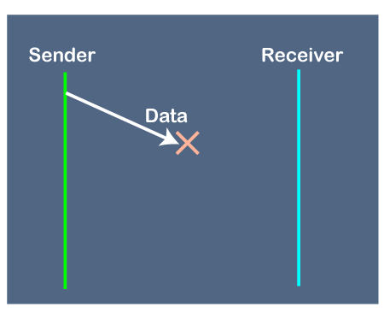
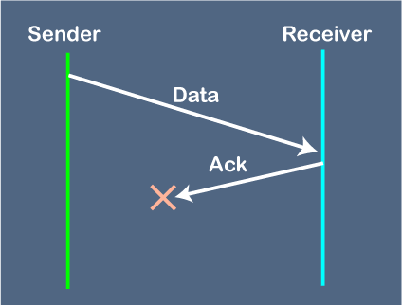
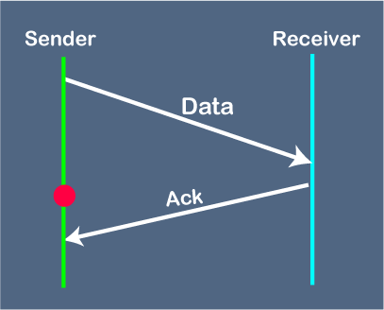
Stop and Wait : Advantage and Disadvantage
Advantage:
It is very simple to implement.
The incoming packet from receiver is always an acknowledgement.
Disadvantage:
Problems occur due to lost data Problems occur due to lost ack Problems occur due to delayed data / ack

Slide 11
Stop and Wait : Numerical Problems
Problem 1. If the bandwidth of the line is 1.5 Mbps, RTT is 45 msec and packet size is 1 KB, then find the link utilization in stop and wait.
Solution- Given- Bandwidth = 1.5 Mbps, RTT = 45 msec, Packet size = 1 KB Hence,
Transmission delay (Tt) = L/B = 1KB/1.5Mbps = (1K x 8 bits) / (1.5 M bits per sec) = 5.461 msec Tcycle​=Tt​+RTT= 5.46+45=50.46 ms Propagation delay (Tp) = RTT/ 2 = 45 msec / 2 = 22.5 msec
Link Utilization or Efficiency (η) = 1 / 1+(2 Tp/Tt) = 1/ (1+(2X22.5)/5.46)=1/(1+8.24)=1 / 9.24 = 0.108 = 10.8 % Link Utilization (U) =Tt/ (Tt+RTT)= 5.46/50.46=0.108 =10.8%
Problem 2. A channel has a bit rate of 4 Kbps and propagation delay of 20 msec. The channel uses stop and wait protocol. To get a channel efficiency of at least 20%, what is the minimum packet size?
Solution: 1 / 1+(2 Tp/Tt) >= 1/4
1/ 1+(2 x 20ms x 4Kbps/ L) >= 1/5 4 >= (2 x 20ms x 4Kbps/ L)
L >= 40 bits

Slide 12
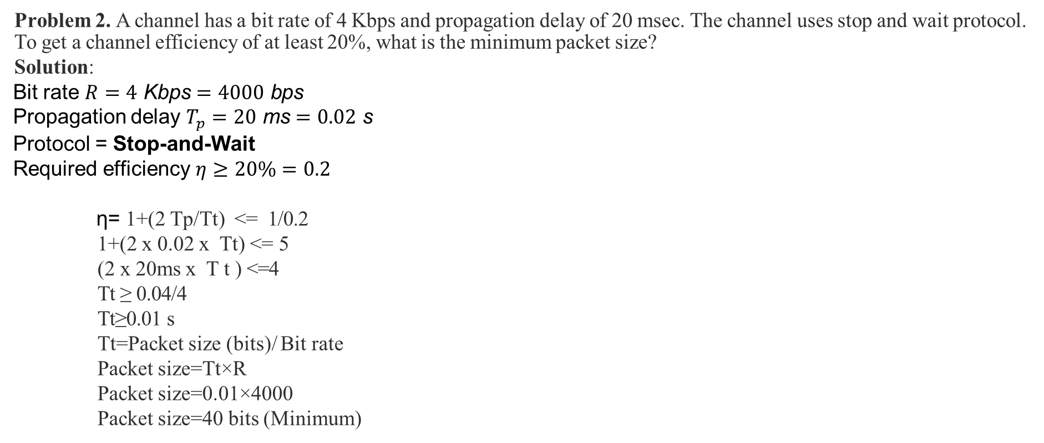
Stop and Wait : Numerical Problems
Problem 2. A channel has a bit rate of 4 Kbps and propagation delay of 20 msec. The channel uses stop and wait protocol. To get a channel efficiency of at least 20%, what is the minimum packet size?
Solution:
Bit rate $R=4 \text{Kbps}=4000 \text{bps}$
Propagation delay $T_{p}=20 \text{ms}=0.02 \text{s}$
Protocol = Stop-and-Wait
Required efficiency $η≥20\%=0.2$
η= 1+(2 Tp/Tt) <= 1/0.2
1+(2 x 0.02 x Tt) <= 5 (2 x 20ms x Tt) <=4
Tt ​≥ 0.04/4 Tt​≥0.01 s
Tt​=Packet size (bits)/ Bit rate
Packet size=Tt​×R
Packet size=0.01×4000 ​ Packet size=40 bits (Minimum)

Slide 13
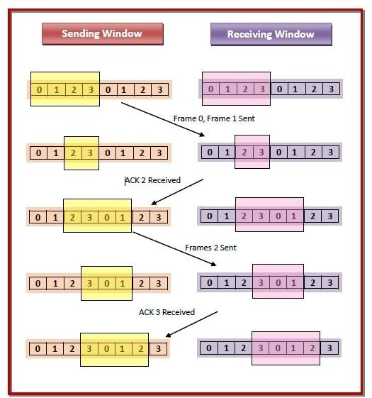
Sliding Window protocol
It allows the sender to send multiple frames before needing the acknowledgements.
Sender slides its window on receiving the
acknowledgements for the sent frames.
Sliding window refers to the imaginary boxes to hold frames and it involves sliding of sender’s window.
The sender has a buffer called the sending window and
the receiver has buffer called the receiving window.
The size of the sending window determines the sequence number of the outbound frames. If the sequence number of the frames is an n-bit field, then the range of sequence numbers that can be assigned is 0 to 2^{𝑛} − 1 . Consequently, the size of the sending window is 2^{𝑛} − 1.
The size of the receiving window is the maximum number of frames that the receiver can accept at a time. It determines the maximum number of frames that the sender can send before receiving acknowledgment.

Slide 14
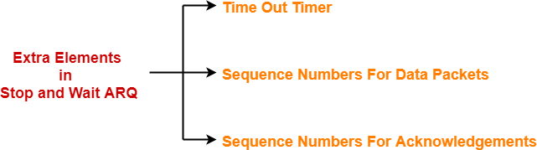
Stop and Wait ARQ (Automatic Repeat reQuest)
Stop and Wait ARQ is an improved and modified version of Stop and Wait protocol.
Stop and Wait ARQ assumes-
The communication channel is noisy.
Errors may get introduced in the data during the transmission.
Working Principle:
It works similar to stop and wait protocol.
It provides a solution to all the limitations of stop and wait protocol.
It includes the following three extra elements.
•

Slide 15
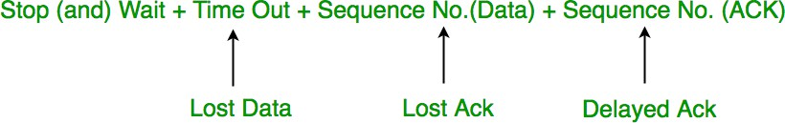
Stop and Wait ARQ
Stop and wait ARQ is a one bit sliding window protocol where Sender window size = 1 and
Receiver window size = 1
Minimum number of sequence numbers required in Stop and Wait ARQ = 2 (Sender Window Size + Receiver Window Size) and the two sequence numbers used are 0 and 1.
For any sliding window protocol to work without any problem,
Available Sequence Numbers >= Sender Window Size + Receiver Window Size

Slide 16
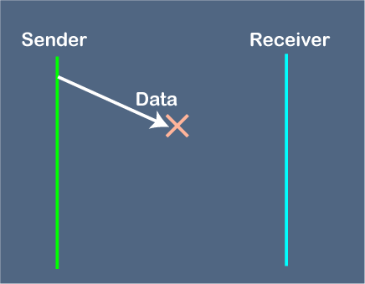
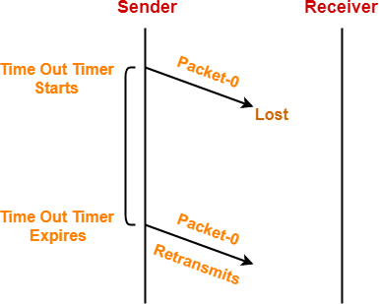
How Stop and Wait ARQ Solves The Problems of Stop and Wait Protocol ?
Problem of Lost Data Packet-
Time out timer helps to solve the problem of lost data packet.
After sending a data packet to the receiver, sender starts the time out timer.
If the data packet gets acknowledged before the timer expires, sender stops the time out timer.
If the timer goes off before receiving the acknowledgement, sender retransmits the same data packet.
After retransmission, sender resets the timer.
This prevents the occurrence of deadlock.

Slide 17
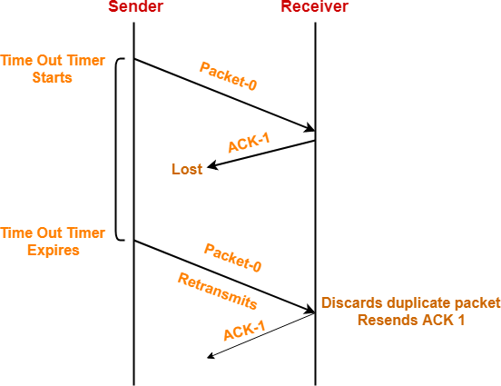
How Stop and Wait ARQ Solves The Problems of Stop and Wait Protocol ?
Problem of Lost Acknowledgement-
Sequence number on data packets help to solve the problem of delayed acknowledgement.
Consider the acknowledgement sent by the receiver gets lost.
Then, sender retransmits the same data packet after its timer goes
off.
This prevents the occurrence of deadlock.
The sequence number on the data packet helps the receiver to identify the duplicate data packet.
Receiver discards the duplicate packet and re-sends the same acknowledgement.

Slide 18
How Stop and Wait ARQ Solves The Problems of Stop and Wait Protocol ?
Problem of Lost Acknowledgement-
Sequence number on data packets help to solve the problem of delayed acknowledgement.
Consider the acknowledgement sent by the receiver gets lost.
Then, sender retransmits the same data packet after its timer goes
off.
This prevents the occurrence of deadlock.
The sequence number on the data packet helps the receiver to identify the duplicate data packet.
Receiver discards the duplicate packet and re-sends the same acknowledgement.

Slide 19
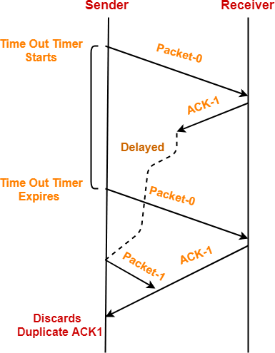
How Stop and Wait ARQ Solves The Problems of Stop and Wait Protocol ?
Problem of Delayed Acknowledgement/Data-
Sequence number on data packets help to solve the problem of delayed acknowledgement.
Consider the ack sent by the receiver gets delayed.
Sender receives no ack and time out occurs, and sender retransmits the same data packet with sequence number-0.
Receiver receives the data packet and discovers it as duplicate packet. It discards the duplicate data packet and re-sends acknowledgement ACK-1.
Sender receives two acknowledgement ACK1, hence, sender rejects the duplicate acknowledgement.

Slide 20
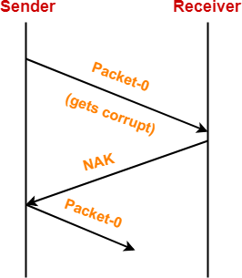
How Stop and Wait ARQ Solves The Problems of Stop and Wait Protocol ?
Problem of Damaged Packet-
If receiver receives a corrupted data packet from the sender, it sends a negative acknowledgement (NAK) to the sender.
NAK requests the sender to send the data
packet again.

Slide 21
Disadvantage of Stop and Wait ARQ
The Stop and Wait ARQ may cause big performance issues as the sender always waits for acknowledgement even if it has the next packet ready to send. Consider a situation where you have a high bandwidth connection and propagation delay is also high (you are connected to some server in some other country through a high-speed connection). To solve this problem, we can send more than one packet at a time with a larger sequence number. We will be discussing these protocols in the next articles.
Stop and Wait ARQ may work fine where propagation delay is very less for example LAN connections but performs badly for distant connections like satellite connections.

Slide 22
Self Practice Questions
Using stop and wait protocol, sender wants to transmit 10 data packets to the receiver. Out of these 10 data packets, every 3rd data packet is lost. How many packets sender will have to send in total?
A sender uses the stop and wait ARQ protocol for reliable transmission of frames. Frames are of size 1000 bytes and the transmission rate at the sender is 80 Kbps. Size of an acknowledgement is 100 bytes and the transmission rate at the receiver is 8 Kbps. The one way propagation delay is 100 msec. Assuming no frame is lost, the sender throughput is bytes/sec.

Slide 23
References
https://www.javatpoint.com/sliding-window-protocol
https://www.gatevidyalay.com/stop-and-wait-protocol-practice-problems/
https://www.gatevidyalay.com/stop-and-wait-arq-sliding-window-protocols/
https://www.geeksforgeeks.org/stop-and-wait-arq/
https://www.youtube.com/watch?v=n09DfvemnTQ
https://www.youtube.com/watch?v=vHrvhqHvwW8

